Slide 1

Fake Product Identification by QR Code Using Blockchain
This presentation explores the concept of utilizing blockchain technology to combat fake product identification by leveraging QR codes.
- Under the Guidance of Prof. P. A. Mane

Slide 2
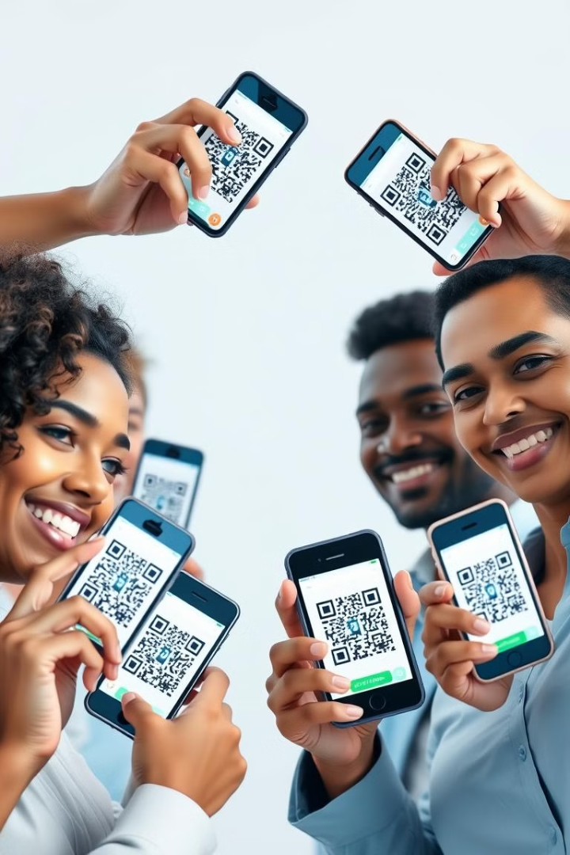
Motivation
1
Transparency & Traceability
Blockchain enables transparent tracking of products throughout the supply chain, making it easier to identify and verify authenticity.
2
Enhanced Consumer Trust
By providing verifiable information about product origins, blockchain can help build trust and confidence among consumers.
3
Reduced Counterfeiting
The immutability of blockchain data makes it extremely difficult to alter or forge product information, discouraging counterfeiters.
4
Improved Supply Chain Efficiency
Blockchain can streamline supply chain processes, improving efficiency and reducing costs for businesses.

Slide 3
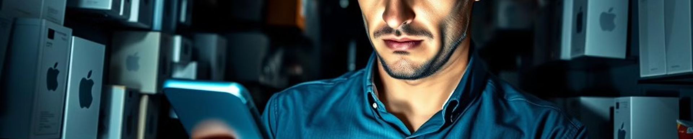
Problem Statement
Design a blockchain-powered system that securely tracks the movement of goods through a supply chain, using QR codes for real-time verification. This solution aims to prevent counterfeit products from entering the supply chain by ensuring data immutability at each checkpoint, from the manufacturer to the customer.

Slide 4

Project Objective
1
Enhance Product Security
2
Simplify Verification Process
Implement a secure, QR and blockchain-based system to validate the authenticity of products, deterring counterfeiters and protecting consumers.
Provide customers with a seamless and user-friendly way to verify the legitimacy of products through a mobile app or website.
3
Increase Brand Trust
Rebuild consumer confidence in brands by offering a transparent and reliable product authentication solution.

Slide 5
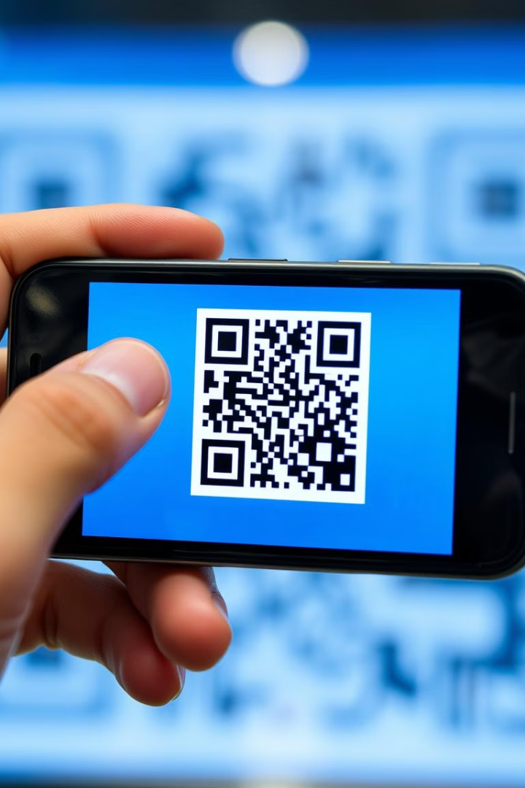
QR Code Integration
Unique QR Codes
Tamper-Proof Design
Each product will be assigned a unique QR code that contains information about the item, including its origin, batch number, and other relevant details.
The QR codes will be designed to be tamper-resistant, ensuring that they cannot be duplicated or altered, further enhancing the security of the system.
Seamless Integration
The QR codes will be seamlessly integrated into the product packaging, allowing customers to easily scan and verify the authenticity of the item.

Slide 6
Scope
Product Authentication
Supply Chain Management
Consumer Engagement
The system will focus on authenticating products using QR codes linked to blockchain records.
Blockchain will be used to track product movement, ensuring transparency and accountability.
Consumers will be empowered to verify product authenticity through easy-to-use mobile apps.

Slide 7
Literature Review
Summary
Title | FAKE PRODUCT DETECTION USING BLOCKCHAIN TECHNOLOGY
Issue Year | April 2022
Name of publisher | Kunal Wasnik, Isha Sondawle, Rushikesh Wani, Namita Pulgam
Institute | Ramrao Adik Institute of Technology
Abstract | Blockchain technology addresses supply chain issues like poor coordination, lack of transparency, and product counterfeiting. It enables secure, decentralized traceability and prevents data tampering, ensuring product authenticity and improving counterfeit detection.
The literature highlights using QR codes with blockchain to securely verify product authenticity and prevent counterfeiting through decentralized tracking.

Slide 8

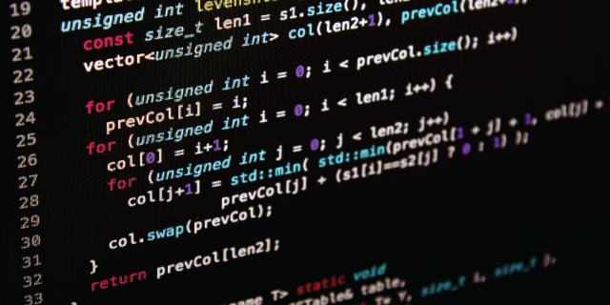
Algorithm
Algorithm 3: Seller Registration
Algorithm 1: Create Product
Input: Minimum amount of registration fee set by manufacturer
Output: Registered Seller
if msg.sender is registered seller then
throw;
end
else
map msg.sender is true
end if
Input: Product Name, Product Price, Product Stock
Output: Added Product
if msg.sender is not manufacturer then
throw;
end
else
insert product in product array
end if
Algorithm 2: Distribute Product
Algorithm 4: Buy Product
Input: Product ID, Seller Name, Amount to Buy
Output: Set Current Owner of product as msg.sender
if msg.sender is not registered seller then
throw;
end
else if msg.value is less that required amount then
throw;
end
else
set product owner name as seller name & store account address of seller
end if
Input: Product ID
Output: Changed Product status
if msg.sender is not manufacturer then
throw;
end
else
change product status to ‘Shipped’ and set order status as complete
end if

Slide 9
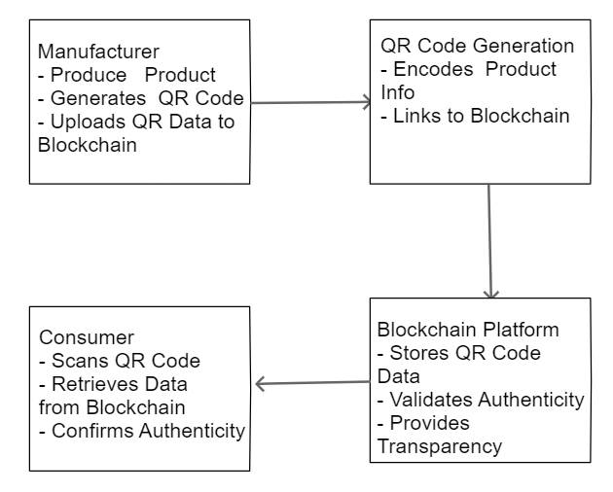
Architecture Diagram

Slide 10
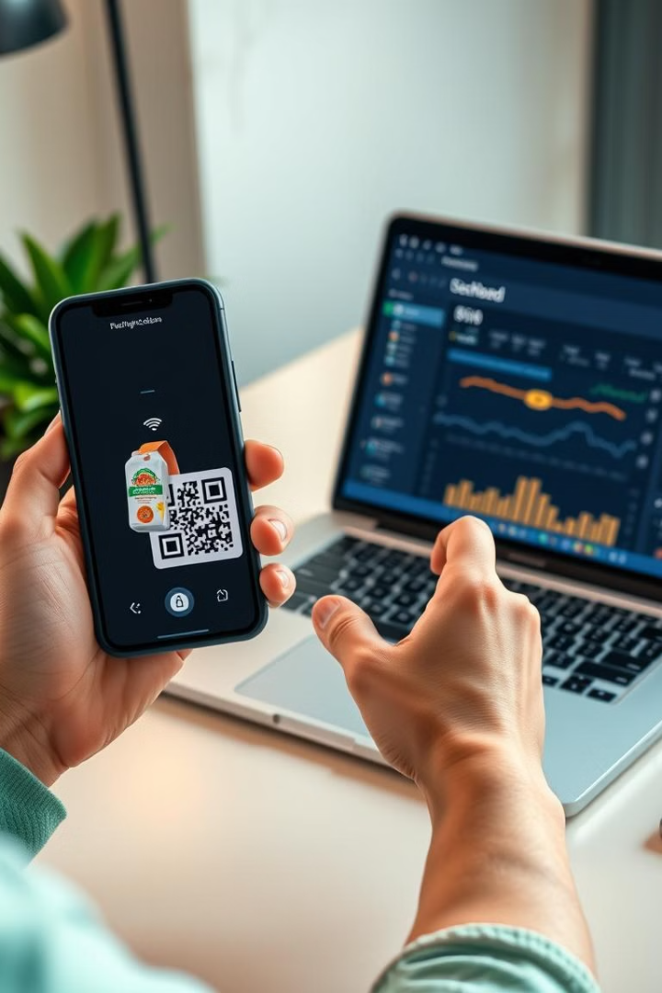

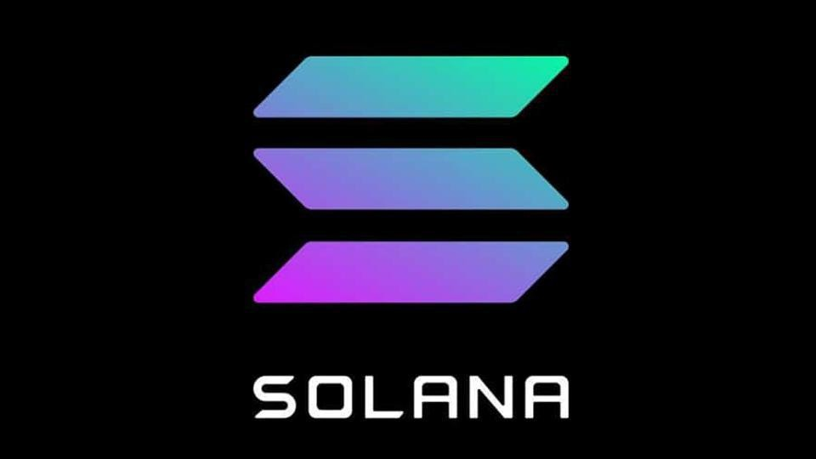

Software Requirement Specification (SRS)
Hardware Requirements:
Computer Equivalent to 8GB RAM, i5 Processor & 512GB SSD
Software Requirements:
Operating System: Windows / MacOS
Latest Browser: Chrome / Brave
Frontend Language: HTML, CSS, JavaScript & ReactJS
Database: SQL Database
Backend Language: NodeJS, Python
Blockchain: Ethereum / Solana / Stellar

Slide 11
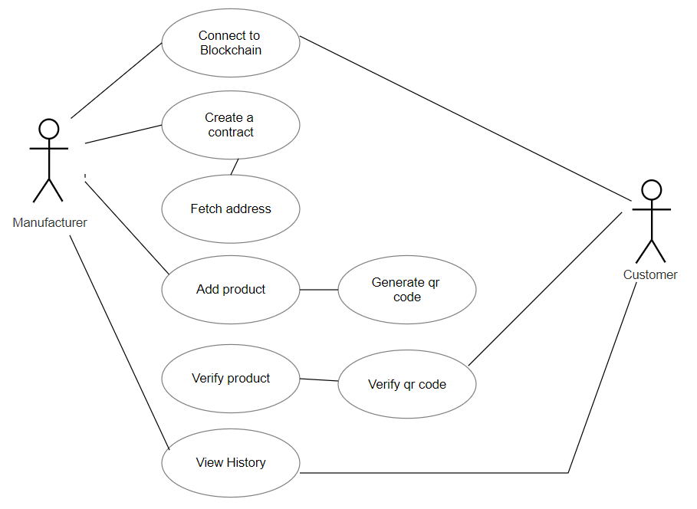
Use Case Diagram

Slide 12
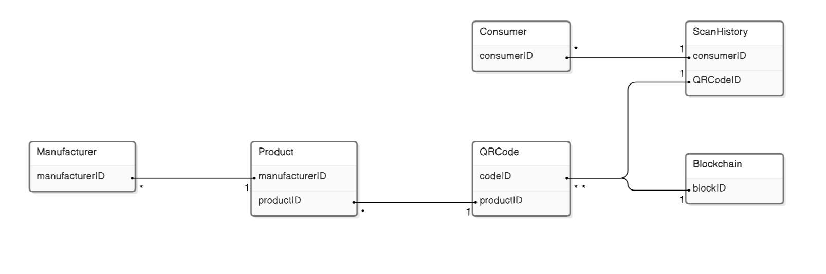
ER Diagram

Slide 13
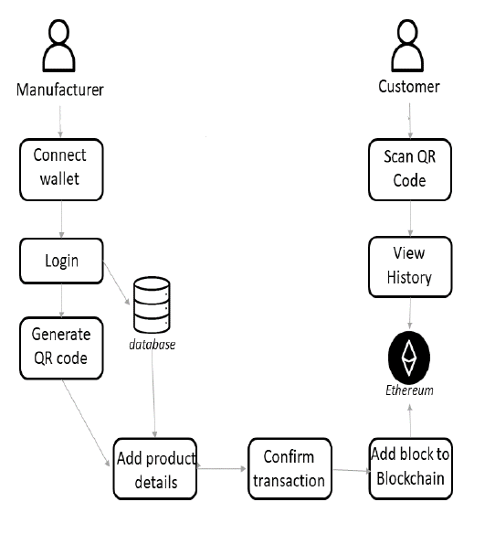
System Flow

Slide 14
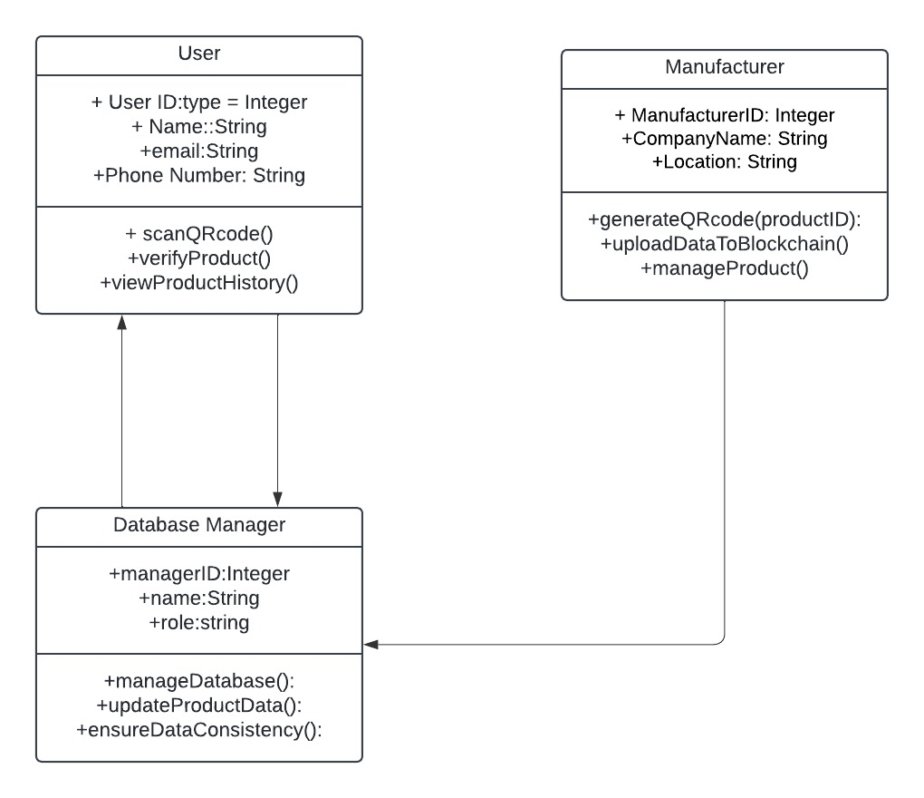
Class Diagram

Slide 15
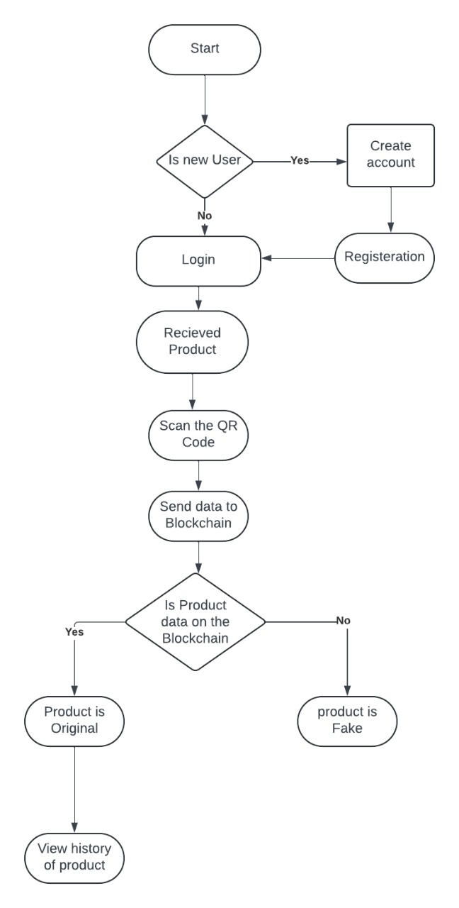
Activity Diagram
(For Customer)

Slide 16
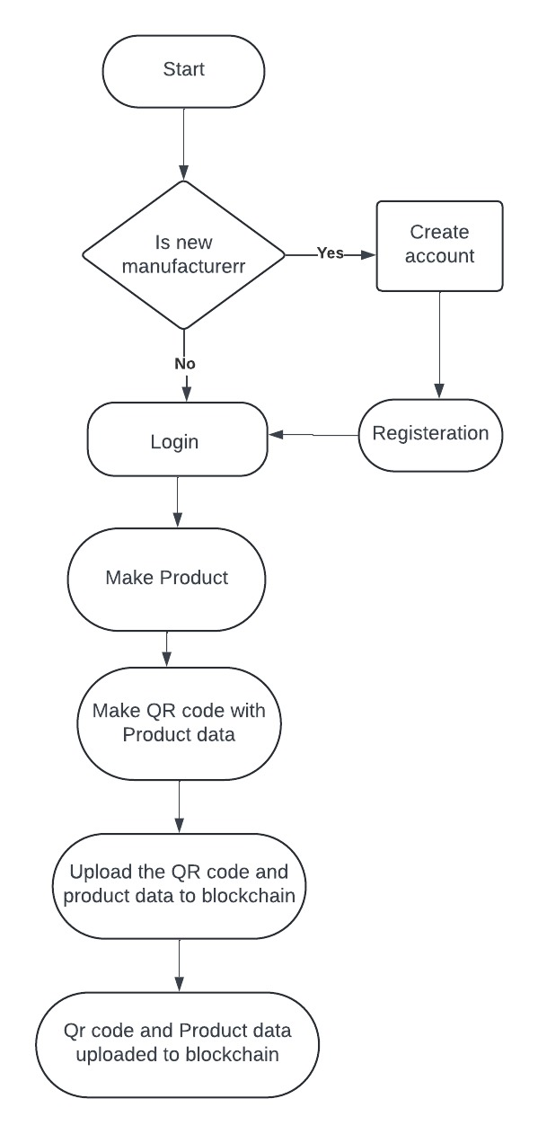
Activity Diagram
(For Manufacturer)

Slide 17
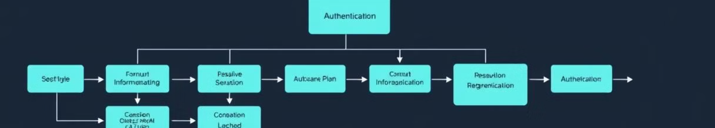




Design
Product Registration
QR Code Scanning
Data Verification
Authentication Result
Legitimate manufacturers will register their products on the blockchain by generating unique QR codes.
Consumers can scan the QR code on a product using their mobile device to verify its authenticity.
The scanned QR code data is compared with blockchain records to verify its authenticity.
The system provides a clear authentication result, indicating whether the product is genuine or counterfeit.

Slide 18
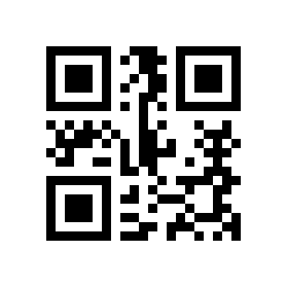
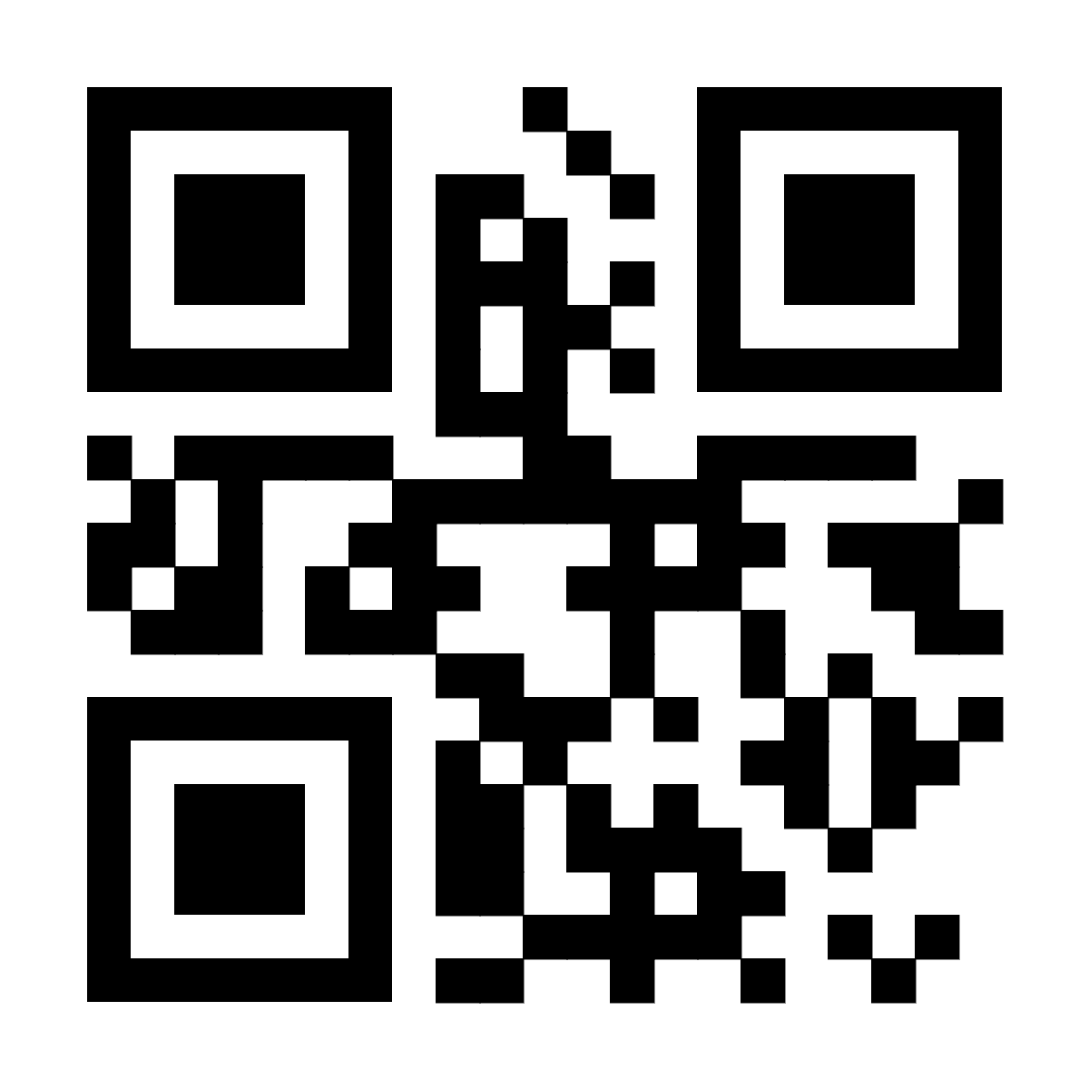
Module 1: QR Code Generation and Encoding
1
2
3
QR Code Generation
Data Encoding
Hash Generation
A unique QR code is generated for each product using a QR code generation library.
Product details, including unique identifier, manufacturer information, and other relevant data, are encoded into the QR code.
A hash function is applied to the encoded data to generate a unique hash value, ensuring data integrity and preventing tampering.

Slide 19
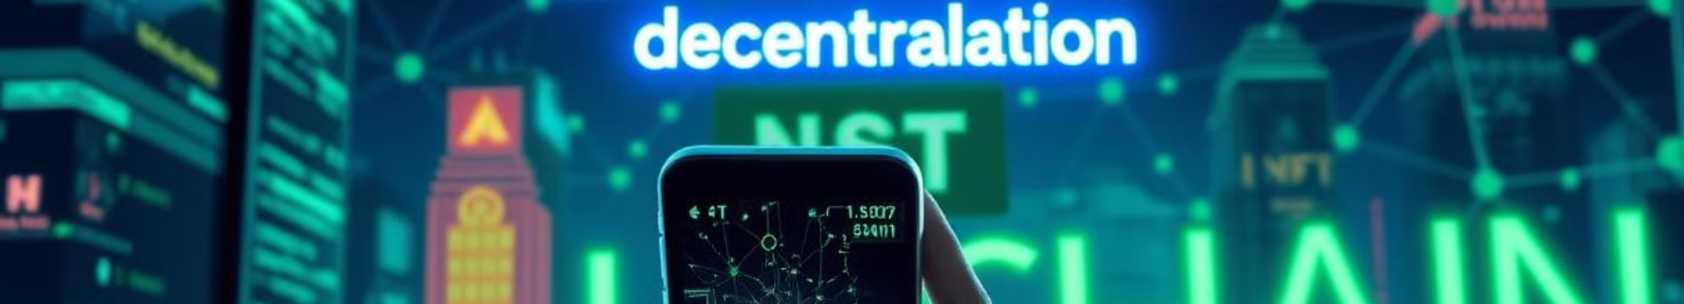



Module 2: Blockchain Integration
Hash Value Storage
Transaction Recording
Smart Contract Implementation
The generated hash value for each product is stored on the blockchain platform, ensuring a secure and tamper-proof record.
Every transaction involving a product's QR code is recorded on the blockchain, providing a complete audit trail and traceability.
A smart contract can be implemented to automate verification processes, ensuring efficient and secure authentication of products.

Slide 20

Module 3: Product Verification and Authentication
QR Code Scanning
Data Extraction
Consumers scan the QR code on the product using a mobile app.
The app extracts the encoded data from the QR code, including the product details and hash value.
Blockchain Verification
Authentication
The app queries the blockchain for the hash value associated with the scanned QR code.
If the hash value matches the blockchain record, the product is authenticated as genuine, and a verification message is displayed to the user.

Slide 21





Conclusion and Future Enhancements
Enhanced Security
Global Reach
This system significantly enhances product security, combating counterfeiting and protecting consumers from fake products.
The blockchain-based system offers global reach, enabling authentication and traceability for products across different regions.
Data Analytics
Future Enhancements
The system provides valuable data on product distribution, sales, and authentication attempts, enabling businesses to improve supply chain management and identify counterfeit trends.
Future enhancements could include integrating the system with other technologies, such as smart contracts for automated payment processes or IoT sensors for real-time product tracking.

Slide 22
References
ASPA, The state of counterfeiting in india 2021, https : / / www.aspaglobal.com / pre_upload / nation / 1623216858-4730baa0efdb83aba174859af0a3a6a5- Report % 20The % 20State % 20of % 20Counterfeiting % 20in % 20India % 202021.pdf (2021)
Y. Lu, Journal of Management Analytics 5, 1 (2018)
. Casino, T.K. Dasaklis, C. Patsakis, Telematics Informatics 36, 55 (2019)
S. Idrees, M. Nowostawski, R. Jameel, A. Mourya, Electronics 10, 951 (2021)
Zignuts Technolab, How blockchain architecture works? basic understanding of blockchain and its architecture., https : / / www.zignuts.com / blogs/ how - blockchain - architecture - works - basic - understanding- of- blockchain- and-its- architecture/ (2022)

Slide 23

Thank You !

